Slide 1
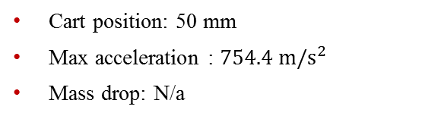
Datasets
High-Rate Overview
Benchmark
Applications
Datasets
Dataset 5 – test 1
Excitations:
Static cart action
Single hammer impact
No electromagnet mass
Cart position: 50 mm
Max acceleration : $754.4 m/s^{2}$
Mass drop: N/a

Slide 2
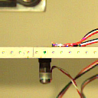
Datasets
High-Rate Overview
Benchmark
Applications
Datasets
Dataset 5 – test 1
Excitations:
Static cart action
Single hammer impact
No electromagnet mass
Cart position: 50 mm
Max acceleration : $754.4 m/s^{2}$
Mass drop: N/a

Slide 3

Datasets
High-Rate Overview
Benchmark
Applications
Datasets
Dataset 5 – test 2
Excitations:
Static cart action
Single hammer impact
No electromagnet mass
Cart position: 50 mm
Max acceleration : $845.9 m/s^{2}$
Mass drop: N/a

Slide 4

Datasets
High-Rate Overview
Benchmark
Applications
Datasets
Dataset 5 – test 2
Excitations:
Static cart action
Single hammer impact
No electromagnet mass
Cart position: 50 mm
Max acceleration : $845.9 m/s^{2}$
Mass drop: N/a

Slide 5

Datasets
High-Rate Overview
Benchmark
Applications
Datasets
Dataset 5 – test 3
Excitations:
Static cart action
Single hammer impact
No electromagnet mass
Cart position: 50 mm
Max acceleration : $481.0 m/s^{2}$
Mass drop: N/a

Slide 6
Datasets
High-Rate Overview
Benchmark
Applications
Datasets
Dataset 5 – test 3
Excitations:
Static cart action
Single hammer impact
No electromagnet mass
Cart position: 50 mm
Max acceleration : $481.0 m/s^{2}$
Mass drop: N/a

Slide 7

Datasets
High-Rate Overview
Benchmark
Applications
Datasets
Dataset 5 – test 4
Excitations:
Static cart action
Single hammer impact
Electromagnet mass
Cart position: 50 mm
Max acceleration : $137.9 m/s^{2}$
Mass drop: No

Slide 8
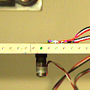
Datasets
High-Rate Overview
Benchmark
Applications
Datasets
Dataset 5 – test 4
Excitations:
Static cart action
Single hammer impact
Electromagnet mass
Cart position: 50 mm
Max acceleration : $137.9 m/s^{2}$
Mass drop: No

Slide 9

Datasets
High-Rate Overview
Benchmark
Applications
Datasets
Dataset 5 – test 5
Excitations:
Static cart action
Single hammer impact
Electromagnet mass
Cart position: 50 mm
Max acceleration : $185.5 m/s^{2}$
Mass drop: No

Slide 10
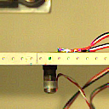
Datasets
High-Rate Overview
Benchmark
Applications
Datasets
Dataset 5 – test 5
Excitations:
Static cart action
Single hammer impact
Electromagnet mass
Cart position: 50 mm
Max acceleration : $185.5 m/s^{2}$
Mass drop: No

